Slide 1
Historical Crop Production Dashboard: 1997 - 2015
Trends, Patterns, and Insights from 19 Years of Agricultural Data
Debasish Deka
10/7/24

Slide 2
Exploring Indian Crop Production: Agricultural Insights through SQL and Power BI
Over the past few weeks, I have conducted a comprehensive analysis of crop data in India spanning from 1997 to 2015, utilizing Power BI and SQL. The analysis aimed to uncover trends, patterns, and insights into crop production across various states and districts. By leveraging SQL, I efficiently extracted and manipulated large datasets, ensuring accurate and detailed data preparation. Power BI was instrumental in visualizing this data, enabling the creation of an interactive and insightful dashboard.
The dashboard highlights key metrics such as total production, area cultivated, and average yield, providing a clear overview of crop performance over the years. Additionally, it identifies top and bottom-performing states, districts, and crops, offering valuable insights into regional disparities and potential areas for improvement. Seasonal and category-specific analyses reveal significant variations in production, guiding strategic planning for future agricultural initiatives. Overall, this analysis not only sheds light on historical crop production trends but also serves as a vital tool for policymakers and stakeholders in optimizing agricultural productivity in India.

Slide 3
KEY PERFORMANCE INDICATORS (KPIS)
Total Agricultural Land: Measures the total area used for crop cultivation, indicating the scale of agricultural operations.
Total Production: Quantifies the overall crop yield, reflecting agricultural output across all categories.
Average Yield: Indicates the efficiency of land use by showing production per unit of agricultural land.
State-wise Agricultural Land Distribution: Highlights the top states contributing to the country's total agricultural area.
State-wise Production: Identifies the highest producing states, revealing regional agricultural strengths.
Annual Production Trends: Tracks yearly changes in crop output, showing long-term productivity patterns.
Crop Category Production: Breaks down production by crop types, indicating which categories dominate the agricultural sector.
Individual Crop Production: Highlights the most produced crops, showing which are most significant to the country's agriculture.
Crop Cultivation Area: Shows the land allocation for different crops, indicating farming priorities.
Zonal Production Distribution: Compares production across different geographical zones, revealing regional disparities.
Underperforming States: Identifies states with the lowest production, highlighting areas needing improvement.
Underperforming Districts: Pinpoints specific districts with low agricultural output, useful for targeted interventions.
Underperforming Crop Categories: Shows which crop types have the lowest production, indicating potential areas for agricultural diversification or improvement.
Least Productive Years: Identifies years with lowest crop yields, useful for analyzing historical trends and external factors affecting agriculture.

Slide 4
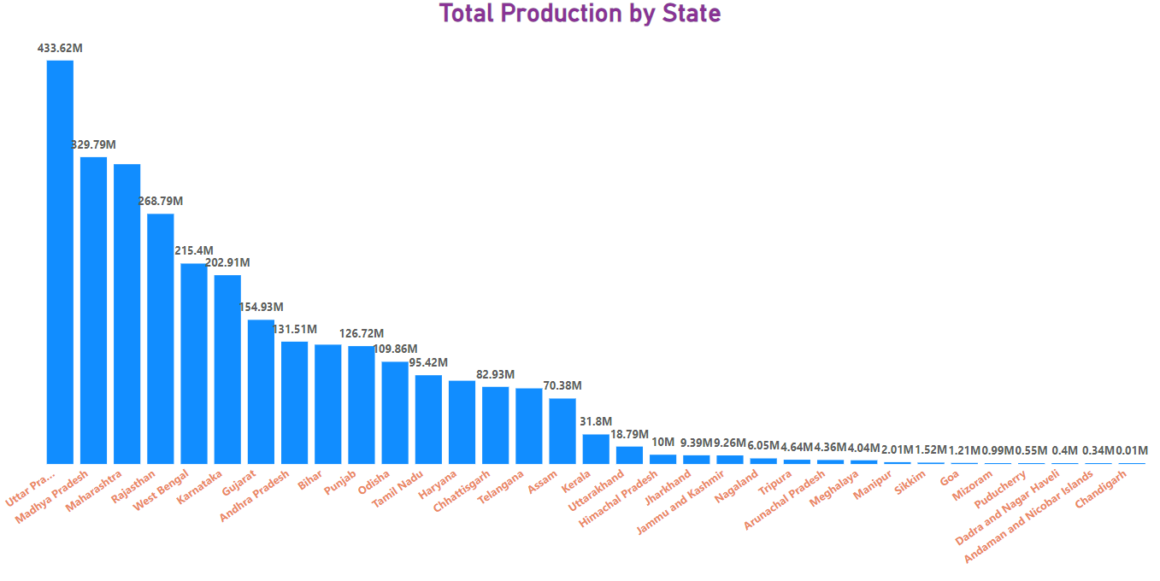

Slide 5
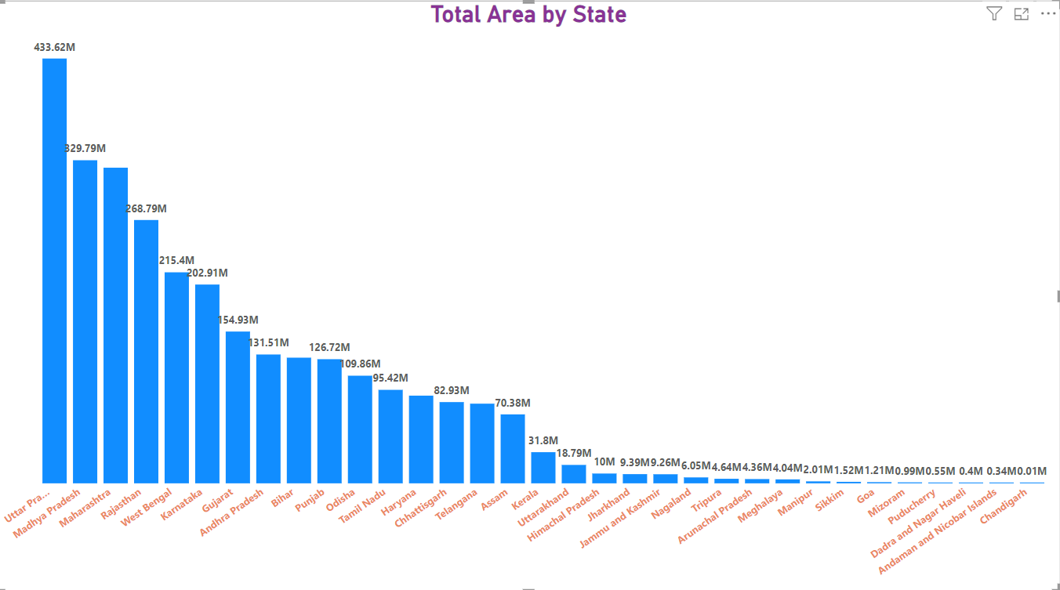

Slide 6
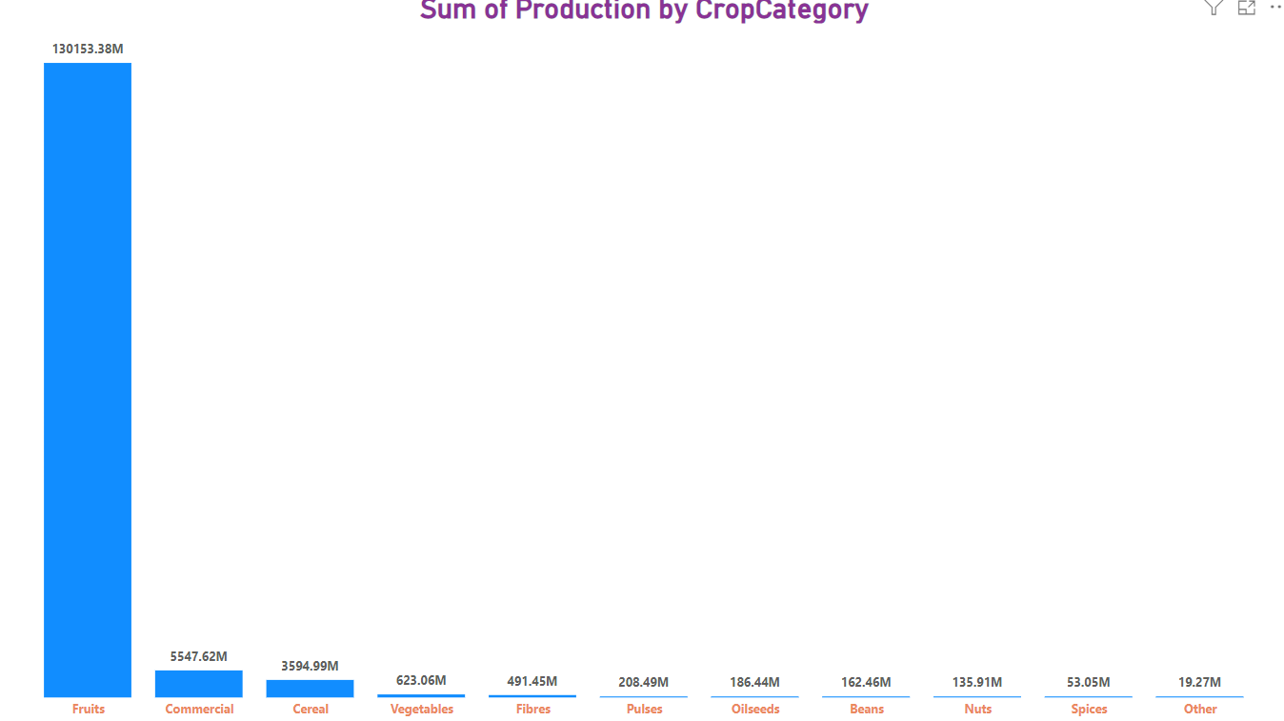

Slide 7
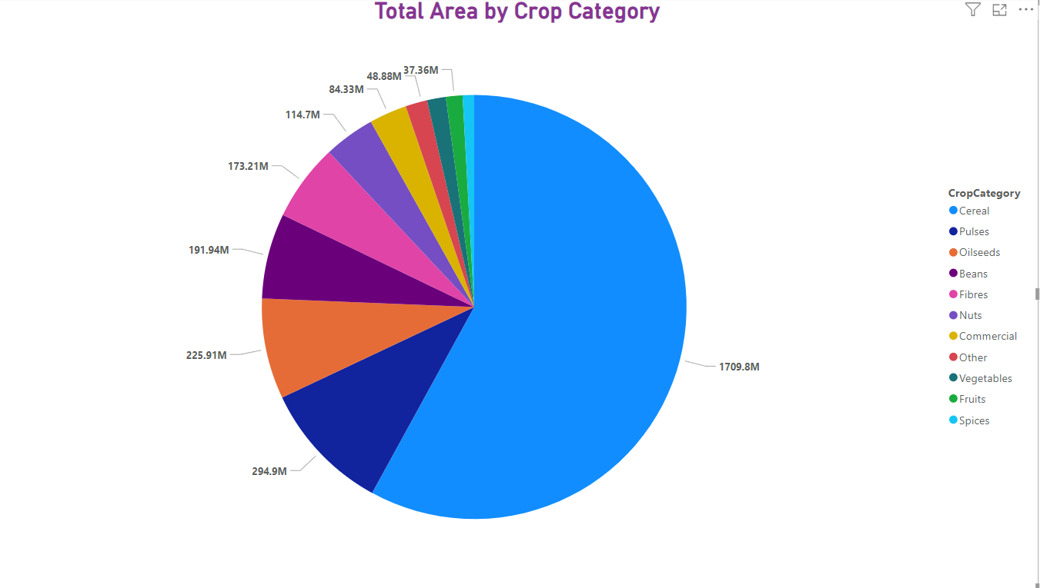

Slide 8
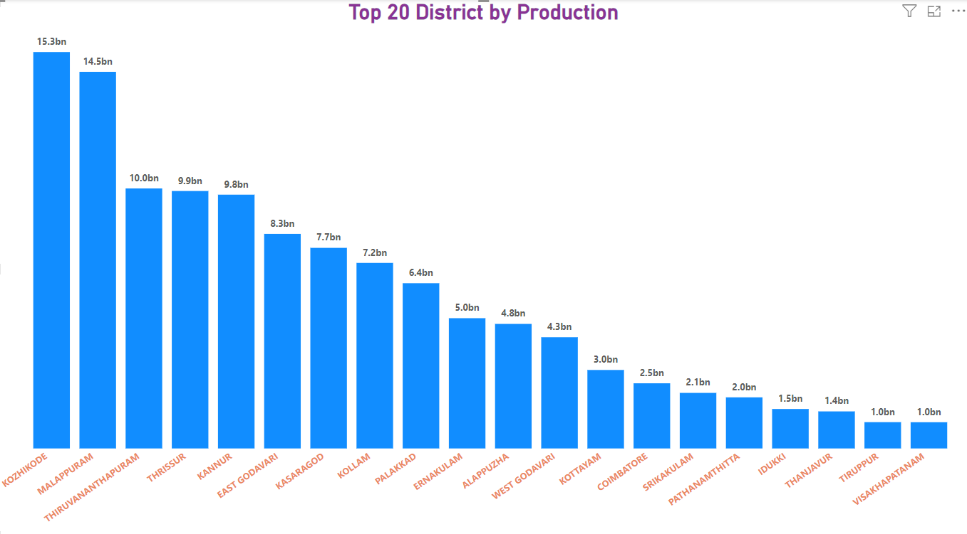

Slide 9
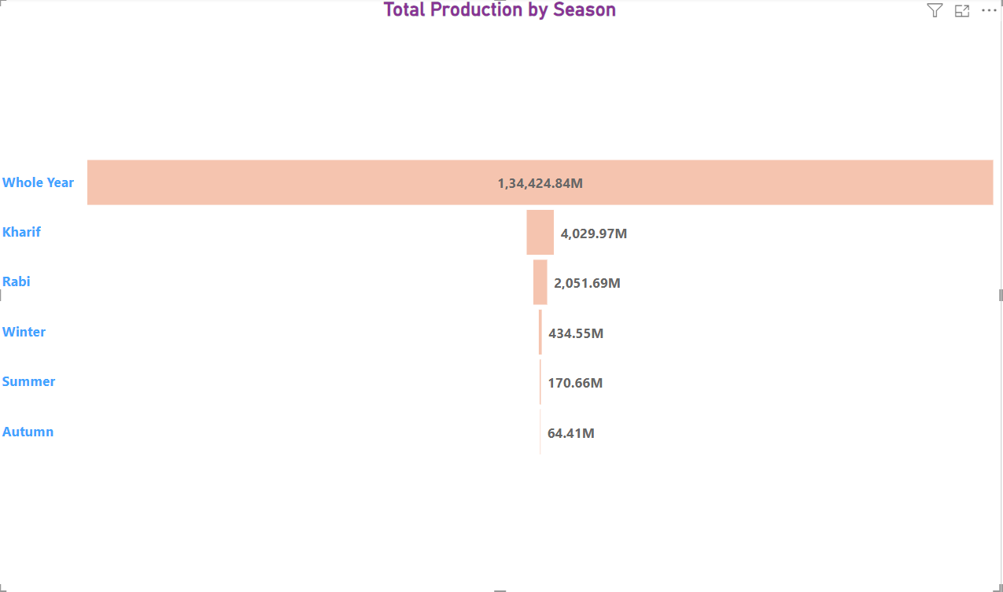

Slide 10
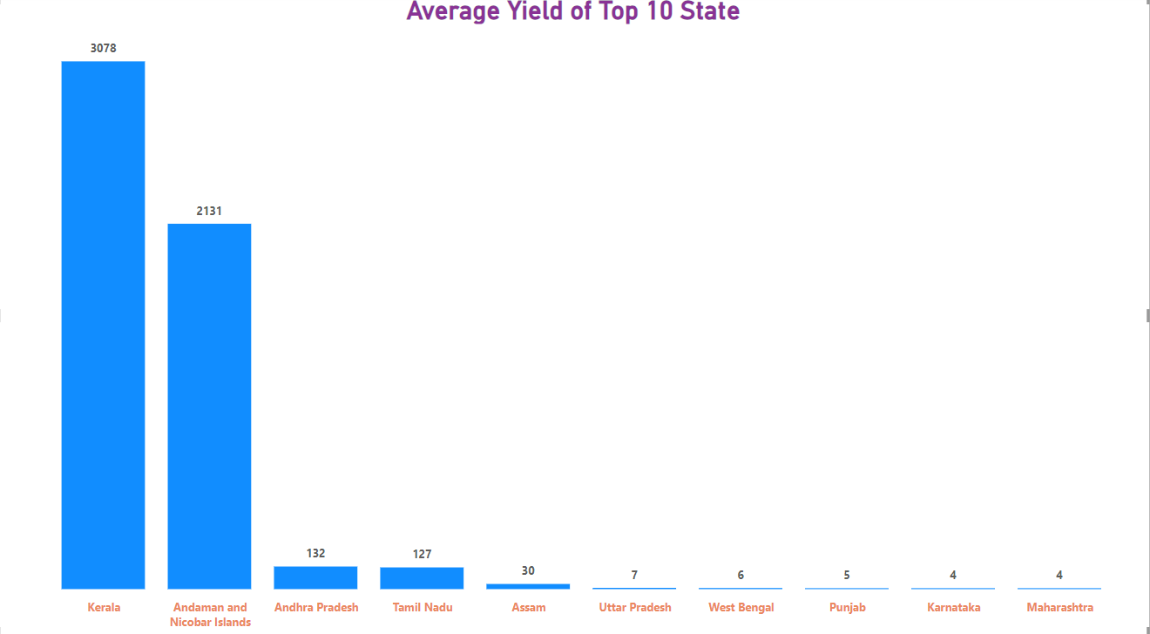

Slide 11
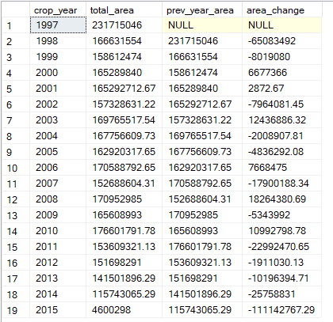
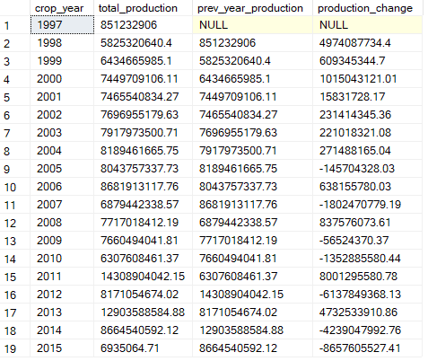
Change in agricultural land and production from 1997 to 2015

Slide 12
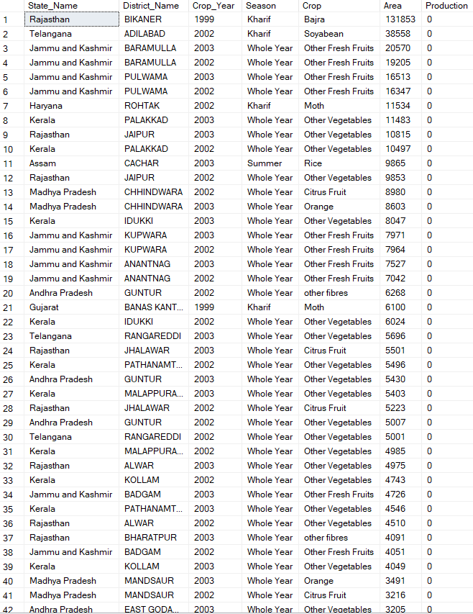
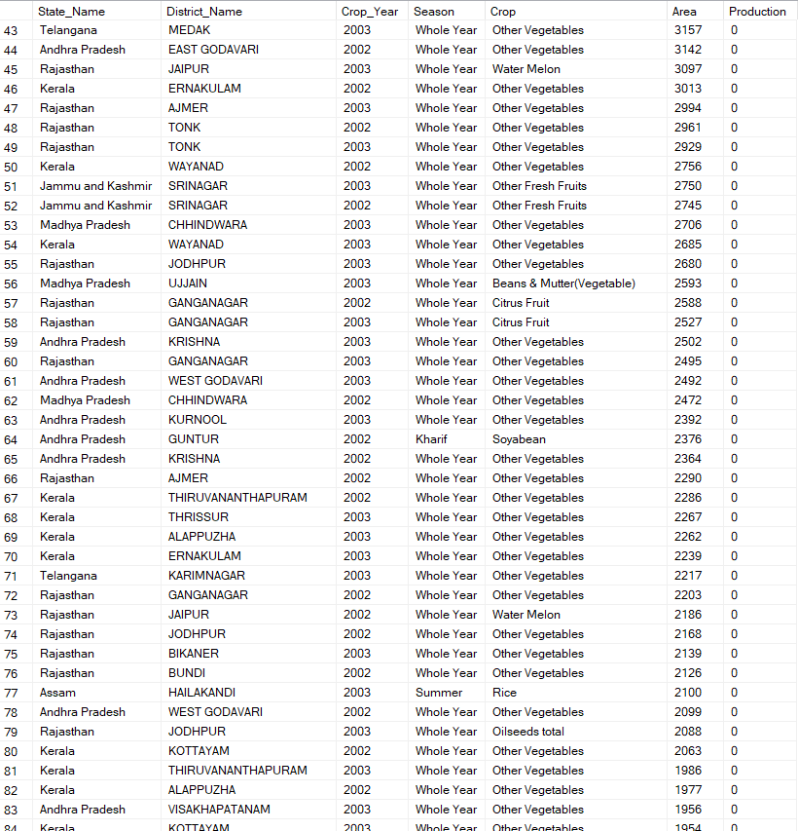
Crop failure identification , where production is equal to "0"
The STATE with highest count of production values that are 0 is “Madhya Pradesh” with count = 1064 out of 3543
The YEAR with highest count of production values that are 0 is 2003 with count = 1589
The CROP with highest count of production values that are 0 is “other vegetables” with count = 286

Slide 13
Insights
The Top 5 Crop on the basis of Production are Coconut, Sugarcane, Rice, Wheat, Potato
Tamil Nadu produced the highest amount of coconut(1250800000) . Year wise 2014 was the year when production reached the peak production. District wise Coimbatore had the highest amount of coconut production
Tamil Nadu produced the highest amount sugarcane(37158000).Year wise 1997 was the year when production reached the peak production. District wise Villupuram had the highest amount of sugarcane production.
Punjab produced the highest amount of rice(1710000). Year wise 2004 was the year when production reached the peak production. District wise Sangrur had the highest amount of rice production.
Punjab produced the highest amount of wheat(1969000). Year wise 2011 was the year when production reached the peak production. District wise Firozpur had the highest amount of wheat production.
West Bengal produced the highest amount of potato(3530571). Year wise 2010 was the year when production reached the peak production. District wise Hooghly had the highest amount of potato production.

Slide 14
Insights
Top 5 crops by cultivation area are Rice, Wheat, Cotton(lint), Bajra, Jowar
Odisha cultivated the highest amount of rice(687000 ha). Year wise 2012 was the year when cultivation reached the peak. District wise Bargarh had the highest amount of rice cultivation.
Punjab cultivated the highest amount of wheat(422000 ha). Year wise 1997 was the year when cultivation reached the peak. District wise Bargarh had the highest amount of wheat cultivation.
Maharashtra cultivated the highest amount of cotton(lint)(558800 ha). Year wise 2012 was the year when cultivation reached the peak. District wise Jalgaon had the highest amount of cotton(lint) cultivation.
Rajasthan cultivated the highest amount of bajra (1020181 ha). Year wise 2003 was the year when cultivation reached the peak. District wise Barmer had the highest amount of bajra cultivation.
Maharashtra cultivated the highest amount of jowar (726300 ha). Year wise 1997 was the year when cultivation reached the peak. District wise Solapur had the highest amount of jowar cultivation.

Slide 15
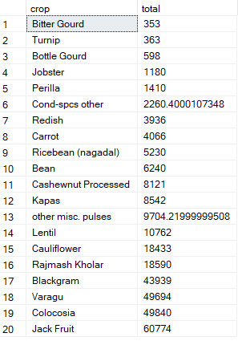
Top 20 lowest productive crops

Slide 16
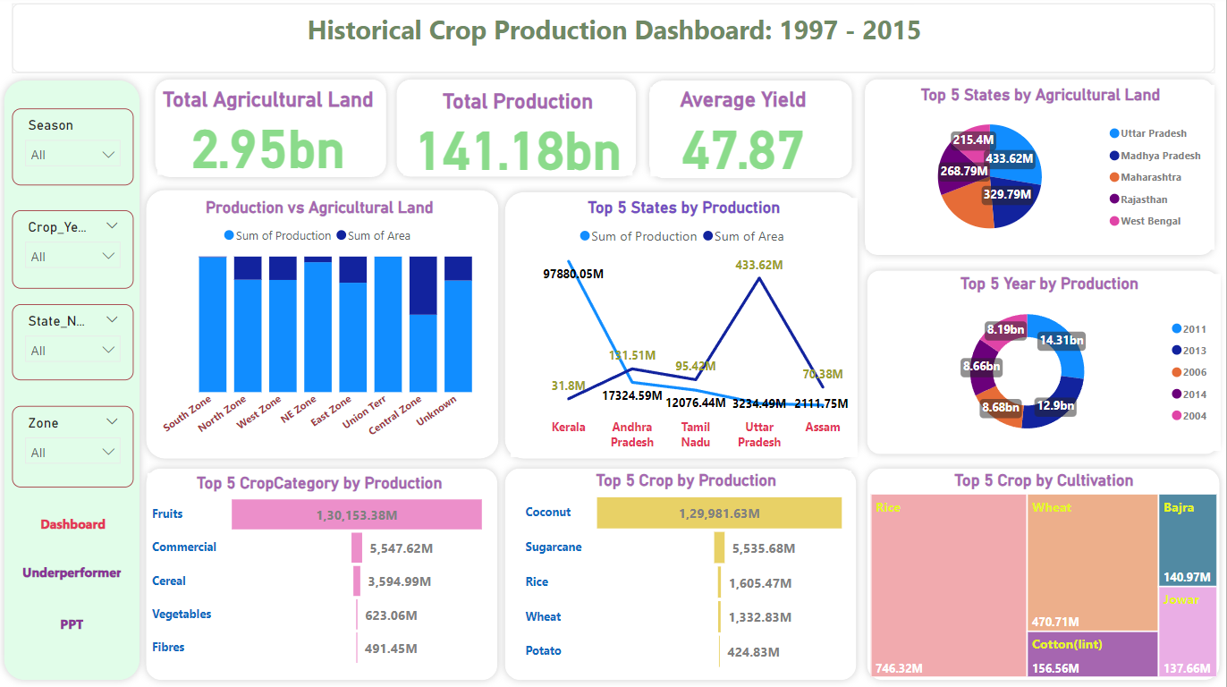
Final Dashboard
Notes:
Final Dashboard

Slide 17
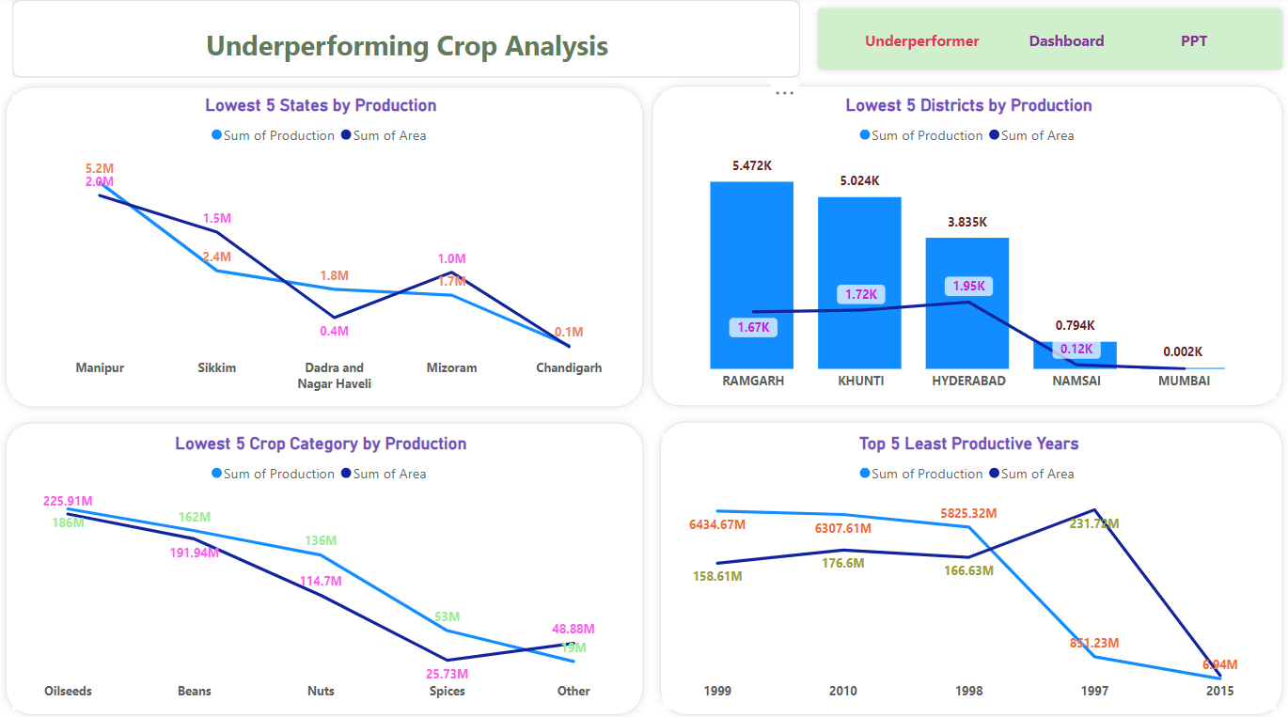
Notes:
Underperforming Crop Analysis

Slide 18
THANK YOU

